Slide 1
C.2.10 Sample Questions

Slide 2
C.2.10 Sample Questions

Slide 3
C.2.10 Sample Questions

Slide 4
C.2.10 Sample Questions

Slide 5
C.2.10 Sample Questions

Slide 6
C.2.10 Sample Questions

Slide 7
C.2.10 Sample Questions

Slide 8
C.2.10 Sample Questions

Slide 9
C.2.10 Sample Questions

Slide 10
C.2.10 Sample Questions

Slide 11
C.2.10 Sample Questions

Slide 12
C.2.10 Sample Questions

Slide 13
C.2.10 Sample Questions

Slide 14
C.2.10 Sample Questions

Slide 15
C.2.11 Sample Questions

Slide 16
C.2.11 Sample Questions

Slide 17
C.2.11 Sample Questions

Slide 18
C.2.11 Sample Questions

Slide 19
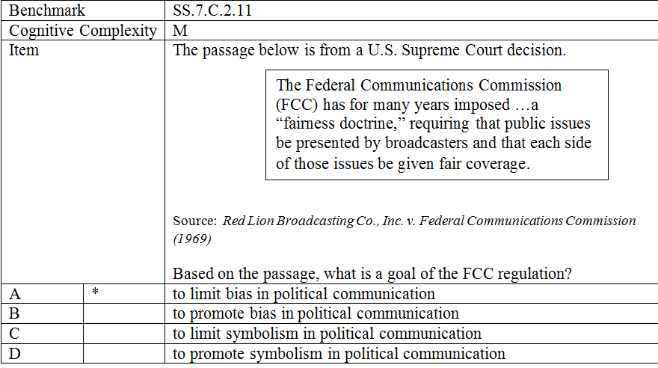
C.2.11 Sample Questions

Slide 20
C.2.11 Sample Questions

Slide 21
C.2.11 Sample Questions

Slide 22
C.2.11 Sample Questions

Slide 23
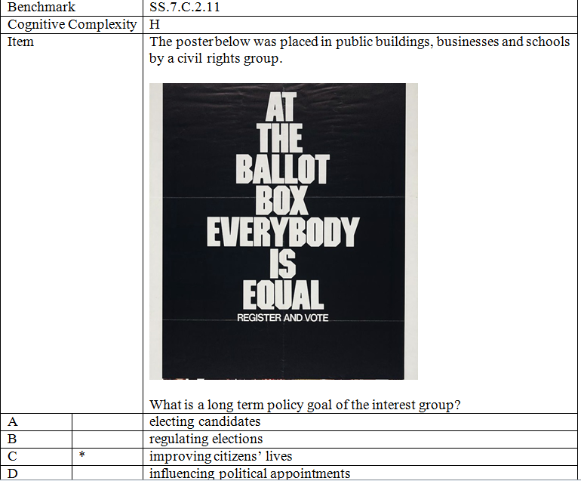
C.2.11 Sample Questions

