Slide 1
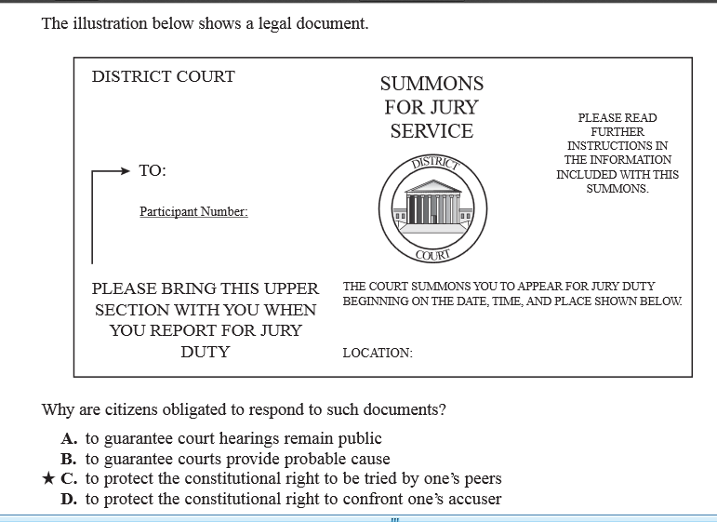
C.2.2 Sample Question

Slide 2
C.2.2 Sample Question

Slide 9
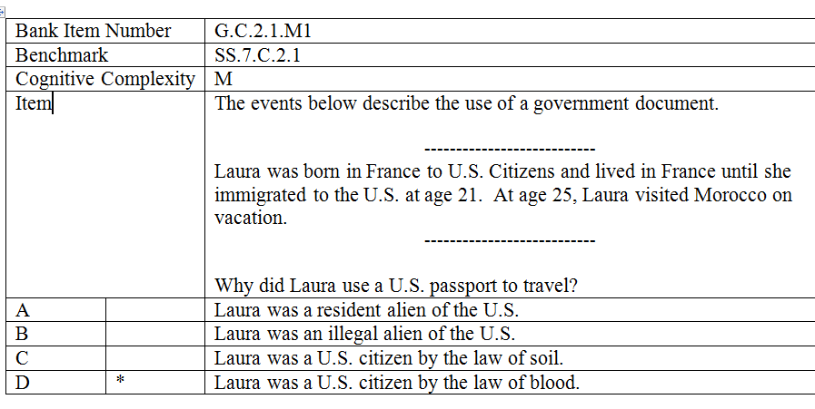

Slide 11
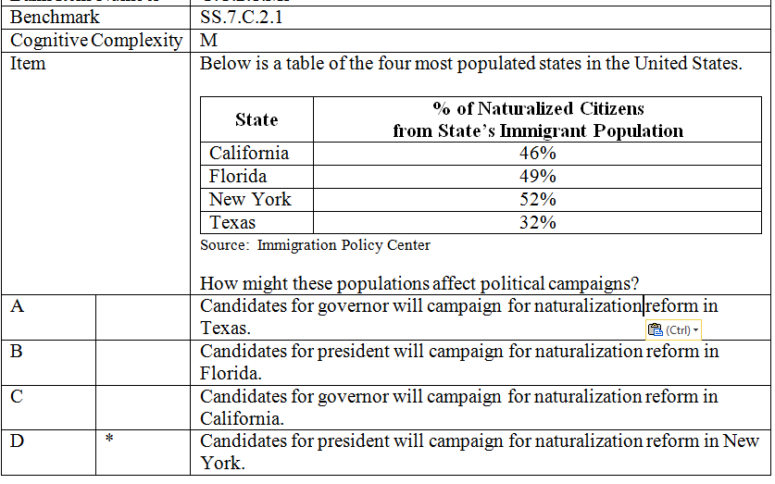

Slide 13
Which practice is part of the obligation of a U.S. citizen to help defend the nation?
Serve on a jury
Register for selective service
Vote in all national elections
Keep informed about national issues

Slide 14
Which practice is part of the obligation of a U.S. citizen to help defend the nation?
Serve on a jury
Register for selective service
Vote in all national elections
Keep informed about national issues

