Slide 1
Mesopotamian Empires
The First Empires

Slide 2
The First Empires
2,000 BCE, Sumer’s city-states were weakened from fighting
Powerful kingdoms began to arise in the northern part of Mesopotamia
Rulers of these kingdoms would build empires – group of many different lands under one ruler

Slide 3
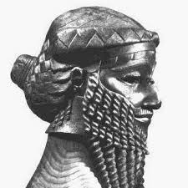
Who Was Sargon?
In northern Mesopotamia there was a kingdom called Akkad
Akkad was lead by the king Sargon
2340 BCE, Sargon would move his well trained army south, conquering each of the city-states (Ur, Uruk, and Eridu)
Sargon became known as the king of Sumer and Akkad
This would become the first empire
This empire would last more than 200 years

Slide 4
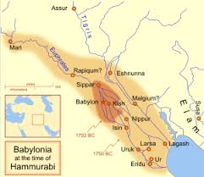
Who Was Hammurabi?
The Amorites lived west of Mesopotamia
1800 BCE, they would conquer Mesopotamia building their own cities
Babylon was the grandest of them located in modern day Iraq
1792 BCE, Hammurabi began conquering the Amorite cities
He created the Babylonian Empire
This empire stretched from the Persian Gulf west to the Mediterranean Sea.

Slide 5
Hammurabi’s Code
Hammurabi is best known for creating a set of laws for his empire
This code was posted for all to read
The code dealt with almost every area of life: crimes, farming, business, marriage, and the family
The code listed a punishment for each crime
It became known as “an eye for an eye, and a tooth for a tooth”
This meant the punishment for each crime should match the seriousness of the crime
It was meant to end blood feuds
The code protected the less powerful, it protected wives from abuse by their husbands. It would influence Greece and Rome.

Slide 6
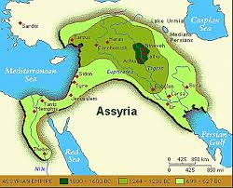
The Assyrian Empire
1,000 years after the empire of Hammurabi, the Assyrian Empire came to power
Assyria was large, extending into present day Turkey, Syria, Iran, and Iraq
They had a large and powerful military
900 BCE, they began taking over the rest of Mesopotamia

Slide 7
Assyrian Army
The Assyrian army was well trained and numbered about 50,000.
The army was infantry (foot soldiers), cavalry (soldiers on horse), and charioteers
They fought with slingshots, bows and arrows, swords, and spears
The army robbed people, set crops on fire, and destroyed towns
They took tribute – forced payments – from conquered people
Stories of Assyrian brutality spread
Sometimes people would be so afraid of them they surrender without a fight

Slide 8
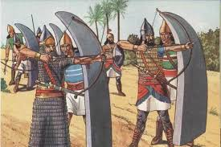
The Assyrian Army
One of their main advantages was the use of iron weapons
The Hittite’s had learned iron production
Iron was much stronger than copper, tin, or bronze
The Assyrians learned this technology from the Hittites

Slide 9
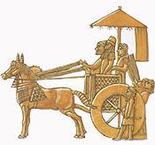
Kings and Government
Assyria extended from the Persian Gulf to the Nile River
Nineveh was the capital along the Tigris River
Assyrian Kings were powerful and divided their kingdoms into provinces
They built roads to connect these provinces
Soldiers would stand guard along the roads to protect merchants
Messengers on government business used the stations to rest and change chariot horses

Slide 10
Life in Assyria
Assyrians had law codes, but their punishments were harsher
Worshipped many of the same gods
They built large temples and palaces filled with wall carvings and statues
Ashurbanipal, an Assyrian king, built one of the first libraries in Nineveh
The library had over 25,000 tablets of stories and songs to the gods
Farming and trade were both important
They would trade for wood and metal to supply their empire

Slide 11
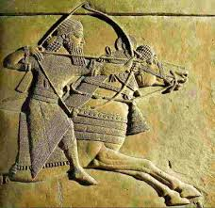
The Chaldean Empire
Assyrian rule lasted for about 300 years
Due to their harsh rule, people would often rebel
650 BCE, fighting broke out over who the next Assyrian ruler would be.
With the infighting, it allowed a different group of people to take power, the Chaldeans

Slide 12
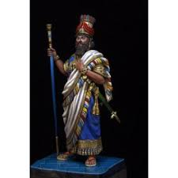
A New Empire
About 1,000 BCE, the Chaldean people had moved into southern Mesopotamia
They were quickly conquered by the Assyrians
The Chaldeans hated the Assyrians and were never completely under their control
627 BCE, the Chaldean king Nabopolassar led a revolt against the Assyrians

Slide 13
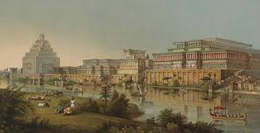
A New Empire
Within a year he had conquered Uruk and was made king of Babylonia
The Medes, another people in the region who wanted to overthrow the Assyrians, joined the Chaldeans
Together, they defeated the Assyrian army
612 BCE, they captured the capital Nineveh and burned it to the ground

Slide 14
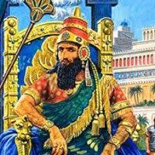
A New Empire
Nabopolassar and his son Nebuchadnezzar created a new empire
They gained control of almost all the lands the Assyrians had once ruled
The city of Babylon was their capital
Sometimes the Chaldean Empire is called the New Babylonian Empire

Slide 15
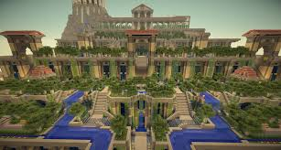
The Greatness of Babylon
King Nebuchadnezzar rebuilt Babylon, making it the largest and richest city in the world
Huge brick walls surrounded the city, with guards patrolling
Palaces and temples were located in the center of Babylon
A huge ziggurat over 300 feet tall and with a gold roof could be seen for miles
The palace had a giant staircase of greenery known as the Hanging Gardens

Slide 16
The Greatness of Babylon
The Hanging Gardens were considered one of the Seven Wonders of the Ancient World
They were terraced gardens-built like huge steps-and included large trees, masses of flowering vines, and other beautiful plants
A complex irrigation system brought water from the Euphrates River to water the gardens
Nebuchadnezzar may have had them built to please his wife

Slide 17
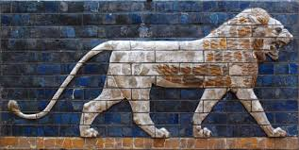
The Greatness of Babylon
Nebuchadnezzar built a beautiful street near the palace that people could visit
It was paved with limestone and marble, and lined with walls of blue glaze tile

Slide 18
The Greatness of Babylon
Each spring, people would crowd into Babylon to watch a gold statue of Marduk as it was paraded through the streets
Chaldeans believed that the ceremony would bring peace and larger crops to the empire
Babylonians built many canals to help irrigate the fields
To pay for all these works and the army Nebuchadnezzar had to collect high taxes and tributes
Since the empire was so large it needed an efficient system of government

Slide 19
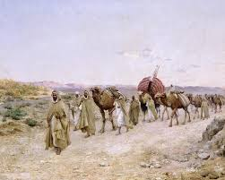
The Greatness of Babylon
A Greek historian in the 400s BCE wrote: “In magnificence, there is no other city that approaches it.”
Artisans made pottery, cloth, and baskets
The major trade route that stretched from the Persian Gulf to the Mediterranean Sea passed through Babylon
Merchants came to the city in caravans (travelling groups)

Slide 20
The Greatness of Babylon
These caravans bought Babylonian goods-pottery, cloth, baskets, and jewelry
Babylon grew wealthy from this trade, under Assyrian rule the area had been poor
They also made scientific advancements
Chaldean astronomers mapped the stars, the planets, and the phases of the moon
The Chaldeans invented the first sundial to measure time and they were the first to have a 7 day week

Slide 21
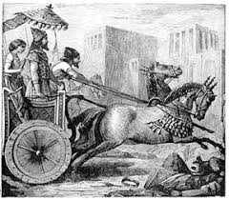
The Fall of the Empire
After Nebuchadnezzar died, several weak kings ruled the Chaldean empire
Poor harvests and slowing trade weakened the empire
539 BCE, the Persians, knowing the Chaldeans had lost their strength, captured Babylon and made Mesopotamia part of their empire
The Persians allowed their newly captured land to keep its distinct culture

