Slide 1
EOC Sample Questions, C.1.6

Slide 2
EOC Sample Questions, C.1.6

Slide 11
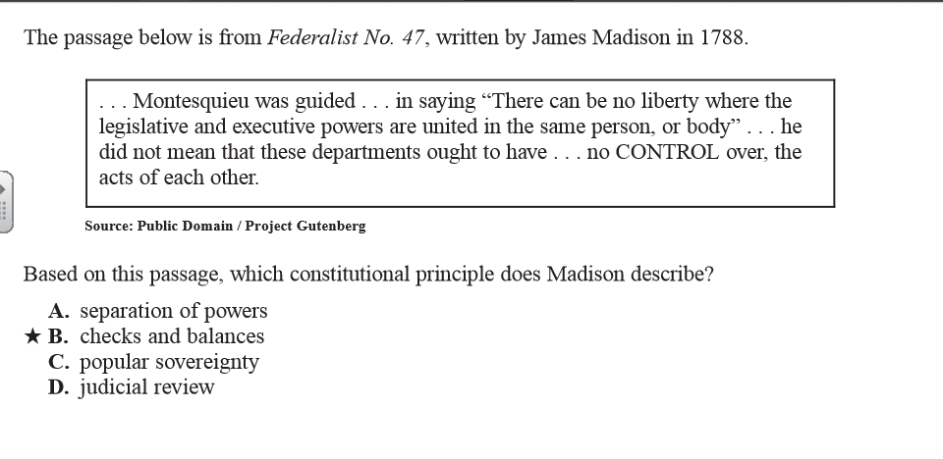
EOC Sample Question, C.1.7

Slide 12
EOC Sample Question, C.1.7

