Slide 1
Mesopotamia
3,000 B.C. to 500 B.C.

Slide 2
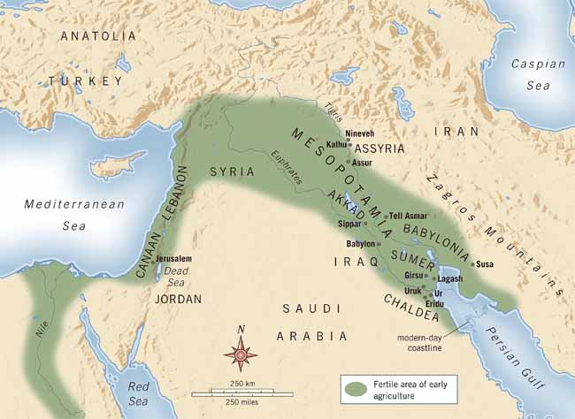
The Sumerians How does geography influence the way people live?
3,000 B.C. we can document the beginning of civilizations in the river valleys of Mesopotamia, Egypt, India, and China
Major factor for these civilizations was access to water for drinking and crops
A shared component for these civilizations was the development of social classes
These social classes were usually based on their jobs or occupations
Other shared characteristics were advances in technology, governments, and a system of values and beliefs

Slide 3
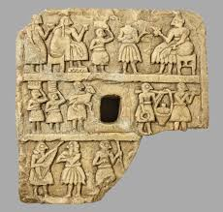
The Two Rivers
Mesopotamia, the earliest known civilization, developed in modern southern Iraq
Mesopotamia, means the “land between two rivers” in Greek
It developed on the plain between the Tigris and the Euphrates rivers
These 2 rivers run parallel for about a 1,000 miles
Mesopotamia was located in the eastern part of the Fertile Crescent

Slide 4
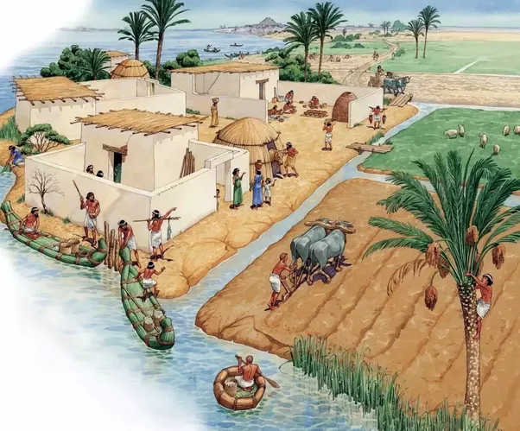
Early Valley Dwellers
1800s, archaeologists began to dig up many buildings and artifacts
7,000 B.C. – first settlers settled in the area
They were hunters and herders
4,000 B.C. – some of these groups moved to the plain of the Tigris-Euphrates valley
They built farming villages along the two rivers

Slide 5
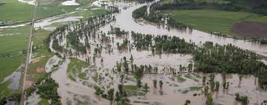
Taming the Rivers
Early farmers used the water from the rivers to water their farms
This was not always reliable since little to no rain fell in the summer, causing the rivers to run low
During the spring harvest, melting snow and heavy rainfall, would cause the rivers to sometimes flood.
These floods would sweep away or destroy crops, homes, and livestock
The benefit to the floods would be the silt (small particles of soil) left behind. This silt was very good for farming

Slide 6
Taming the Rivers
Overtime, people would learn to build dams to help with the flooding
They would also dig canals to let water flow into their fields, this is called irrigation
These advances allowed farmers to grow surpluses, or extra amounts, of food
When food became plentiful, not everyone needed to farm
Artisans, skilled workers, began to develop
They would specialize in weaving cloth and making pottery, tools, and weapons
As artisans made more goods, people began to live in places that favored trade
Small farming communities grew into cities
3,000 B.C., several cities developed in Sumer, a region in southern mesopotamia

Slide 7
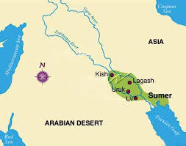
Sumer’s Civilization
Sumer’s people were known as Sumerians
They built the first cities in SW Asia, including Ur, Uruk, and Eridu
These cities became centers of civilization that controlled the lower part of the Tigris and Euphrates valleys

Slide 8
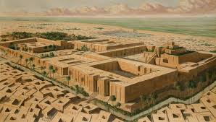
City-States Arise: Ur, Uruk, and Eridu
Sumer’s cities were surrounded by mudflats and patches of scorching desert
This made it difficult to travel to different cities
Each city was largely cut off from each other
Sumerian cities would become independent
As each city grew larger it gained more control, political and economic, of the surrounding areas
They became city-states
Each had its own government and was NOT part of any larger governing state
The population of the city-states ranged 5,000 to 20,000 people

Slide 9
City-States Arise: Ur, Uruk, and Eridu
Historians believe the city-states was protected by a large city wall
Sumerians most likely used mud from the rivers as their main building supply because wood and stone were in short supply
They mixed mud with crushed reeds forming bricks and letting them dry in the sun
The gates to the city wall would remain open during the day and be closed at night
The center of the city-states would be where the ruler’s palace, a large temple, and other public buildings would be found
These city-states would often go to war with each other
They would fight for resources, political borders (expand territory), or for glory
Sometimes they would form alliances with each other for protection

Slide 10
Gods, Priests, and Kings
Sumerians worshipped many gods, this is known as polytheism
They thought some gods had power of rain and wind
They also thought some gods guided the things people did, like plowing or brick-making
They would honor whatever god helped them with their activity
Each city-state claimed one of the gods as their own
The ziggurat (translated to rise high), a large temple, would be where they honored their god
The very top was a holy place, the god’s home, and only special priests were allowed to go there

Slide 11
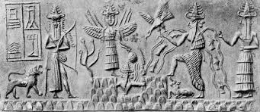
Gods, Priests, and Kings
In the beginning, the city-states were ruled by the priests of the ziggurat
The Sumerian city-states would become monarchies eventually
The kings claimed they received their power to rule from the city’s god
The first kings were probably war heroes
Eventually their rule would become hereditary, meaning if a king dies his son would take over
In most cases the wives of kings did NOT have any political power
Some wives, of the king, did control their own lands

Slide 12
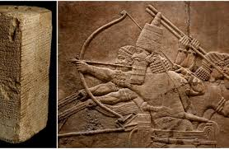
Social Groups
People were divided into social classes
Usually people would stay in the social class they were born – once a farmer always a farmer
The upper class was made up of: Kings, priests, warriors, and government officials
The middle class consisted of: merchants, farmers, fishers, and artisans
The lowest class would be slaves, mostly people captured in war but could also be criminals and people who could not pay their debt

Slide 13
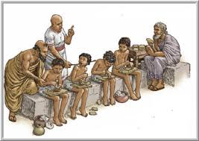
Social Groups
Women and men had different roles
The family was the basic unit in society
Men were the head of the home
Boys went to school and trained for a specific job
Women ran the home, taught their daughters to do the same, and cared for the children
Women had FEW civil rights, though some did own businesses
Law required adult children to take care for their parents if the parents needed help

Slide 14
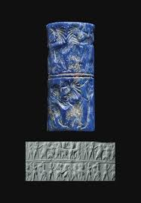
Farmers and Traders
Most Sumerians were farmers
Major crops were: wheat, barley, and dates
Farmers also raised sheep, goats, and pigs
Trade would grow over time allowing Sumerians to gain access to metals
Trade routes linked Sumer to places like India and Egypt
They would travel to other lands for trade: trading wheat, barley, and tools for timber, minerals, and metals to make jewelry and tools
Sumerians valued a red stone called carnelian from India’s Indus Valley
As well as a blue stone know as lapis lazuli from Afghanistan
Traders would bring back iron and silver from Turkey

Slide 15
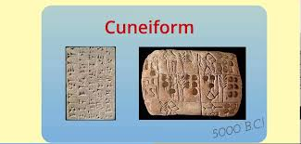
Sumerian Contributions
Mesopotamia is known as the cradle of civilization because later civilizations would copy and improve on Sumerian ideas and inventions

Slide 16
Writing
The Sumerian writing system is the earliest known system in the world
They would keep records of their lives and their history
Their writing system was known as cuneiform made up of about 1,200 different characters
Sumerians wrote on clay tablets (they did not have paper) with a sharp reed
Only a few people, mostly boys, learned to read and write cuneiform
These people would become scribes, or official record keepers
They would record court records, marriage contracts, business dealings, and important events

Slide 17
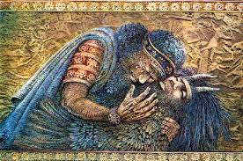
Writing
They would write down oral stories that praised gods and warriors
The oldest known story is from Sumer, the Epic of Gilgamesh, an epic is a long poem that tells the story of a hero

Slide 18
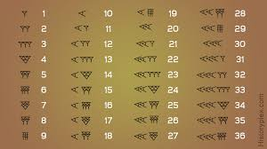
Technology and Mathematics
Sumerians were the first to use the wheel, wood circles, creating carts and later chariots
They developed the sailboat, the potter’s wheel (to make clay pots)
Artisans crafted bronze (made from combining copper and tin) tools, weapons, and jewelry
They developed geometry, created a place value system based on 60, allowing for tables for division and multiplication
The 60-minute hour, 60-second minute, and the 360 degree circle all originated with the Sumerians
By observing the position of the stars, they determined the best time to plant crops and hold religious ceremonies
They also invented a 12 month calendar based on the cycle of the moons

